Slide 1
Introduction to Car Hacking Basics

Slide 2
Disclaimer
If you try to actually take any of this to your car and fry something, I am not liable!
Please don’t sue me I’m poor.

Slide 3
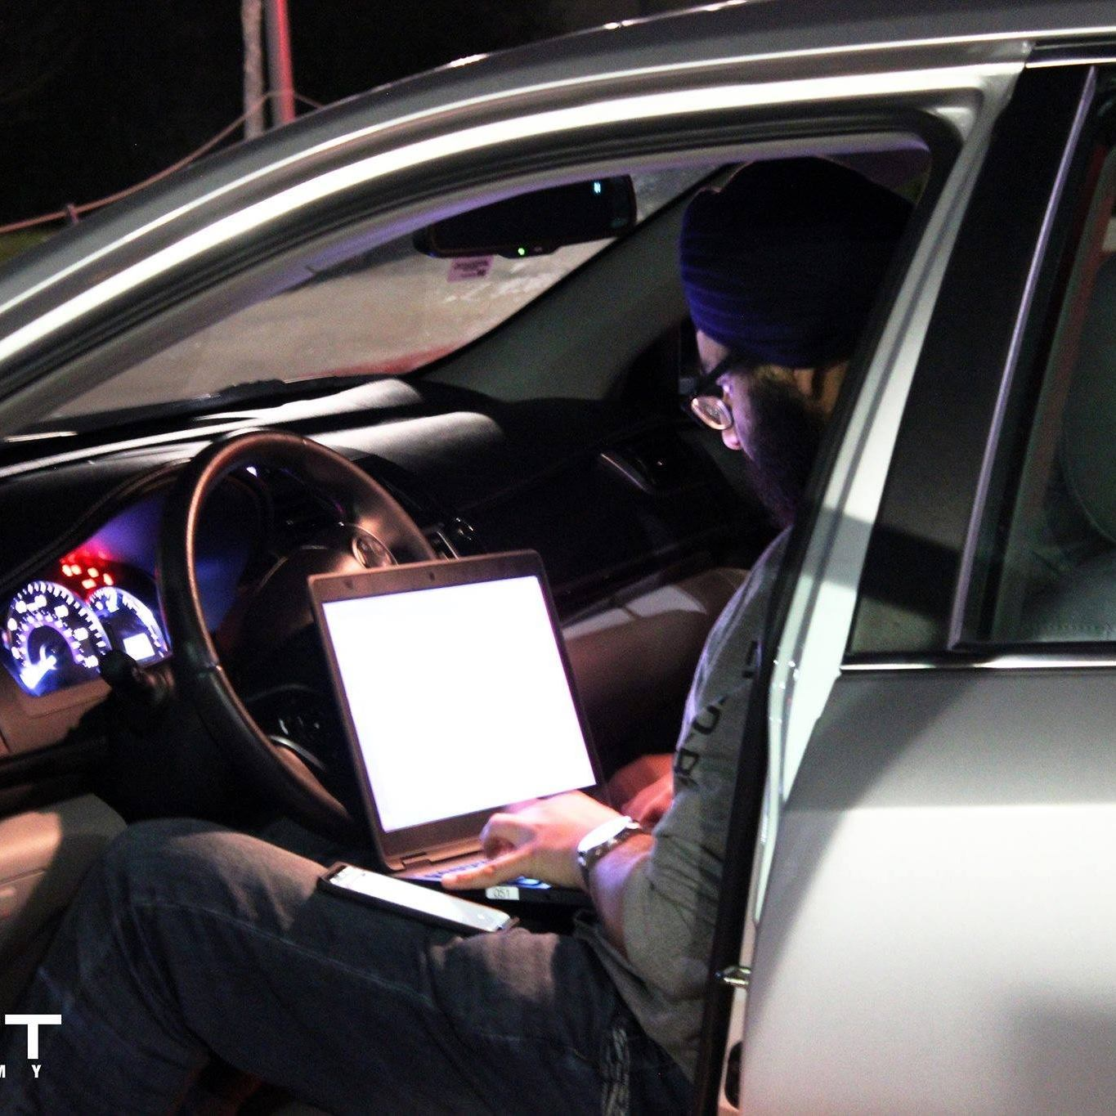
I am not Agent K from Men in Black
Associate IR Consultant at BlackBerry
WRCCDC Black Team
Not related to or am Baby Yoda
Alternate aliases do not include The Child or Grogu

Slide 4
You didn’t come here for a bloody autobiography though

Slide 5
You came here to learn how to do this
But virtually because cars are expensive
And COVID-19 sucks ass

Slide 6
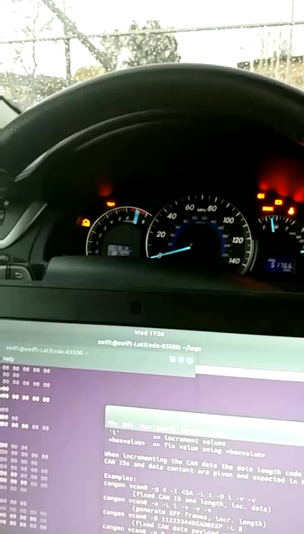

Slide 7
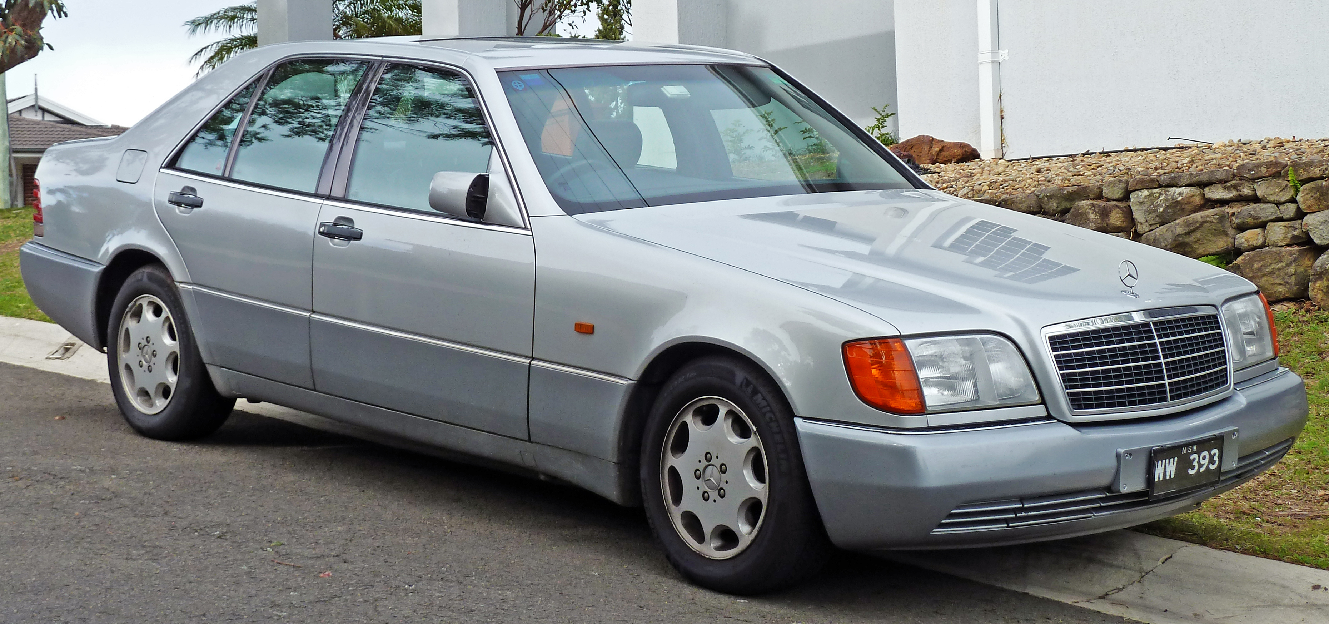
CANBus
Controller Area Network Bus
Connects all the computers/modules in a car together
Created in 1986* by Bosch Electronics.
In use since 1991 with the Mercedes W140.

Slide 8
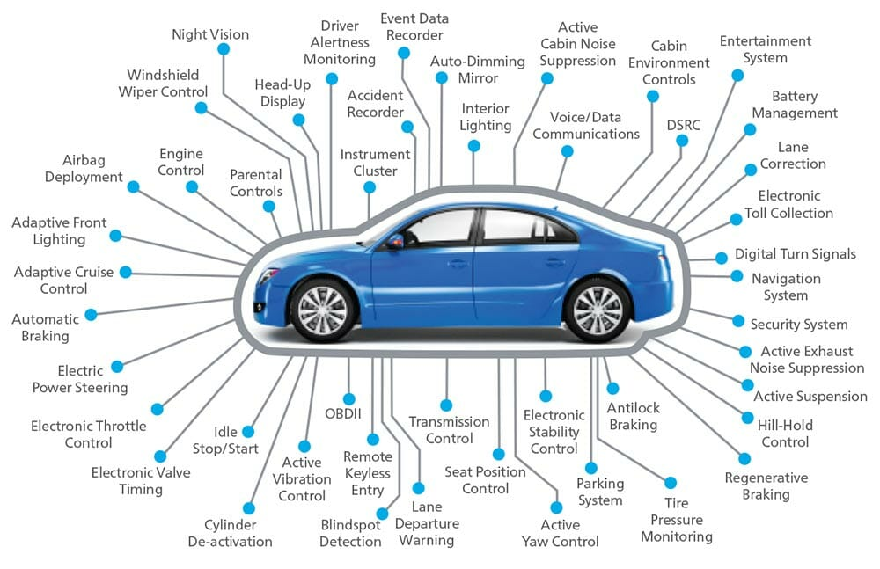

Slide 9
OBD-II
On-Board Diagnostic II
Has been the standard connector since 1996.
Except Tesla apparently
Damnit Elon
Connects to the rest of the car via CANBus

Slide 10
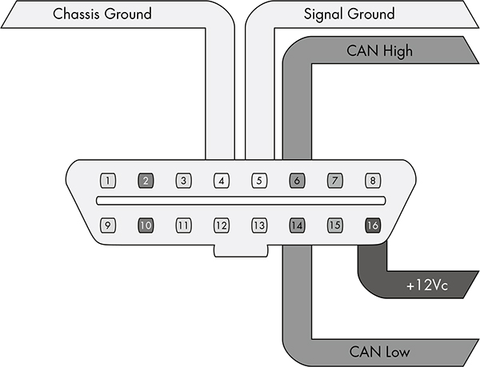

Slide 11
History of Car Network Bullshit
Development started at Robert Bosch GmbH
Mercedes ysed CANBus in the W140 Chassis
ISO 11898 CAN Standard released
LINBus was released
Tesla gives a big middle finger to the OBD-II port
CAN-FD Released
1983
1986
1991
1992
1993
1998
1999
2003
2006
2009
2012
2021
Released at SAE Conference
CAN 2.0 published (yes already)
MOST Cooperation and MOSTBus
LINBus 2.0 was released
FlexRay development and release
Isolationcon: The Second Wave (you’re here)

Slide 12

Modern Cars… Haven’t changed much
CANbus is still the standard for basic communications between all the computers in a car.
Only minor Revisions since 1991.

Slide 13
If it ain’t broke, don’t fix it.. Wait that’s not good
OEMs practice Security through obscurity
CANbus is rarely mentioned by manufacturers.
New tech allows for more attack vectors.
Cellular
Wi-Fi
Bluetooth

Slide 14
Is this pentesting
Reading CANBus can simply be done with a cheap adapter and WireShark.
Injecting packets takes a bit more money
Adapters connect CANBus to a PC via a serial connection
Vcan0, slcan0, can0, etc

Slide 15

Look ma, I shoved a car inside my computer
Ubuntu
Can-tools
ICSim
Windows
Busmaster
Patience
If no patience, anger management classes

Slide 16
Screw your eyes
It’s demo time

Slide 17
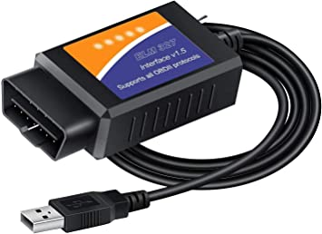
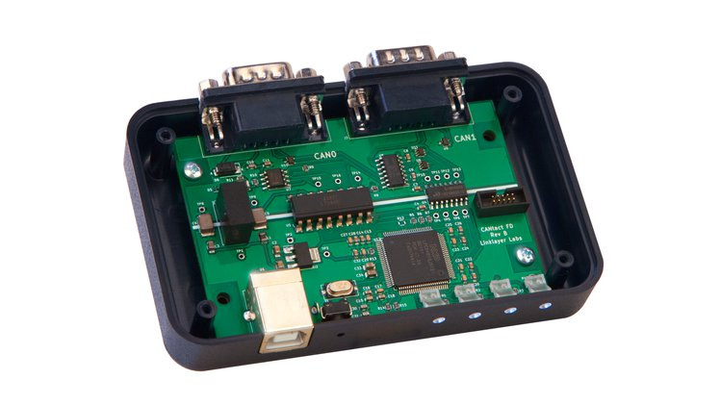
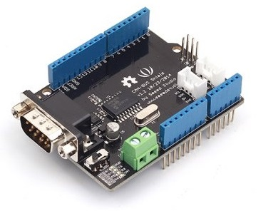
So you wanna break a car
Laptop
ELM327 – 20$
Extremely Limited, no injection support
Arduino and respective shield board e.g seeed studio CAN-Bus Shield v2
CANtact Pro

Slide 18
Thank you!

